Slide 1
MLB Shortstop Case Study
A look into Salaries and Performance of Shortstops (1985-2016)
UT Bootcamp Spring 2018
By: Jordan, Bryan, and Javier

Slide 2
Objective
Salary vs Performance
Salary vs Team Outcome (wins)
Salary Analysis
Perform various comparisons of Shortstop players’ historical data.
Evaluate if the costliest Home Runs per Shortstop influenced the team's season.
Analyze and compare the players salaries adjusted for inflation.

Slide 3
Challenges deep-dive
Gathering Data
Git Hub
Focusing Analysis
Reliable Sources
Our project used data from Data.World instead of paying a subscription to historical and recent data.
Analysts Level of Experience
GitHub is a tool used to collaborate. Each one of us has a different level of experience and had to work through the workflow of merging our code.
So Many Variables
Aside from the vast amount of data we collected, determining how to focus our analysis was challenging.

Slide 4
Salary vs Performance
Determine if there is a relationship between salary and widely-used statistical measures
by Jordan Tata

Slide 5
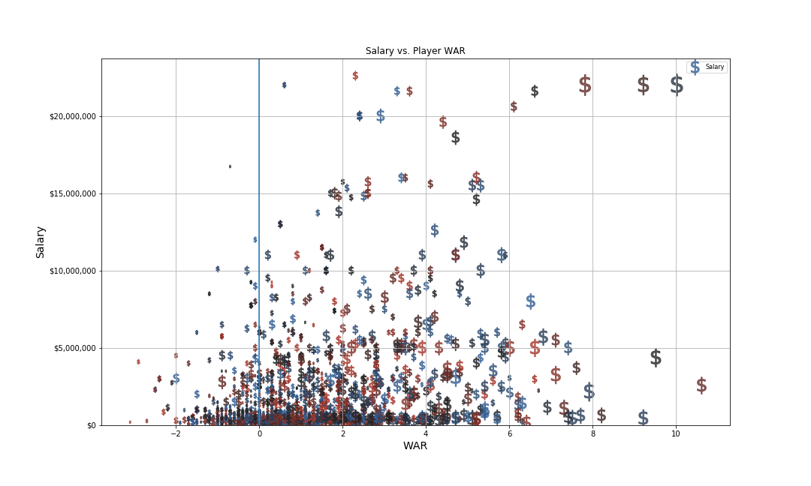
Salary vs. WAR

Slide 6
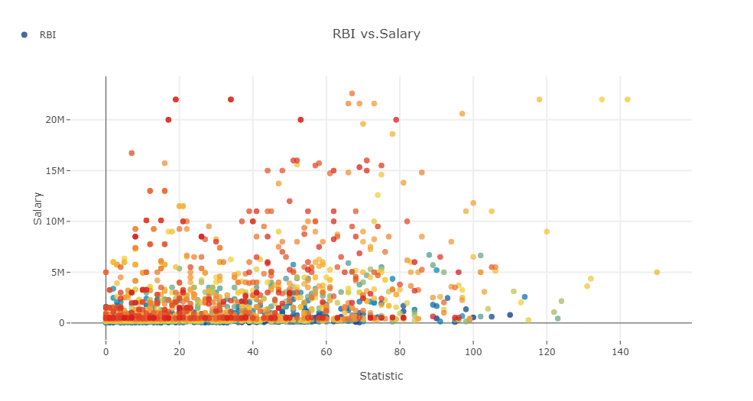
Salary vs. RBI

Slide 7
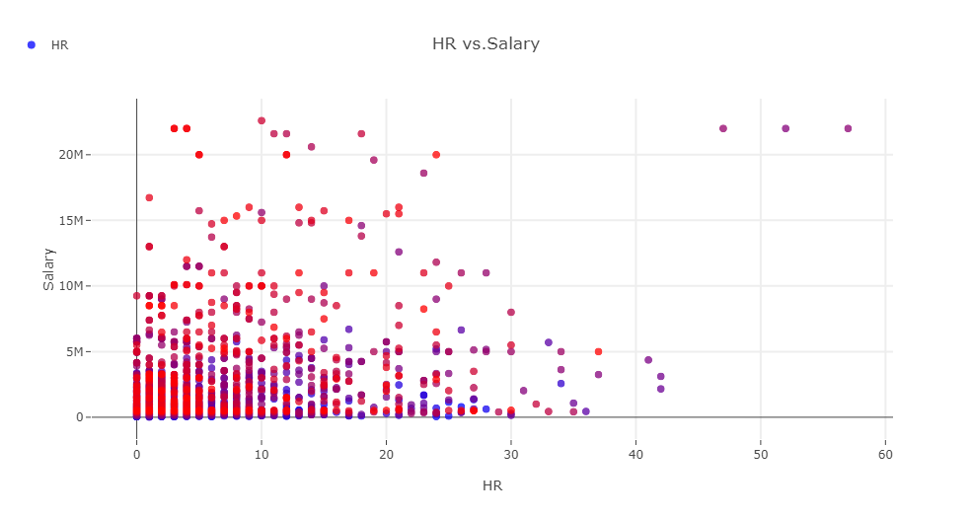
Salary vs. HR

Slide 8
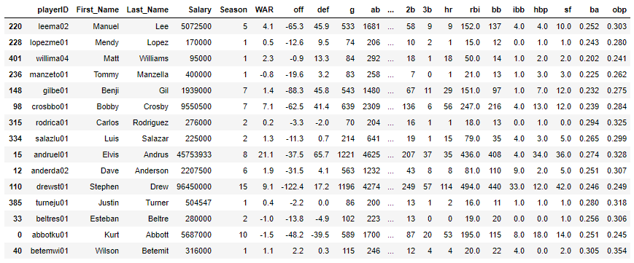
Consolidate Data
Previous plots showed data for every SS, for every season they played since 1985
Some players had 15 individual points, while many showed data for 1 or 2 games played in a season.
Consolidated data by Season to aggregate the statistics by that player’s career numbers and earnings for the timeframe.

Slide 9
Findings
The clearest correlation between salary and performance is based upon the number of home runs the player hits and their WAR.
WAR is a new statistic created in the “Moneyball” era, however, so players whose careers occurred before this statistic became recognized as a legitimate measure, and may not have hit as many home runs, did not get compensated proportionally.
Batting average data is skewed, and needs to be manipulated further to parse out the players with a certain number of qualifying AB’s. (As with all statistical measures based upon an average per season)

Slide 10
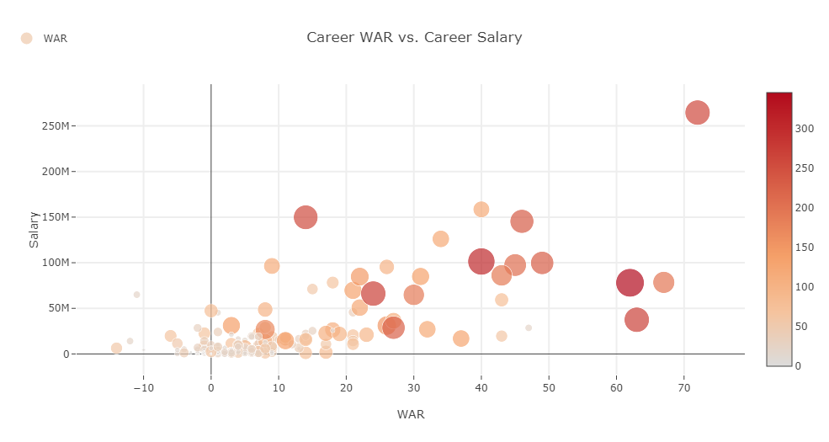
WAR vs. Total Salary

Slide 11
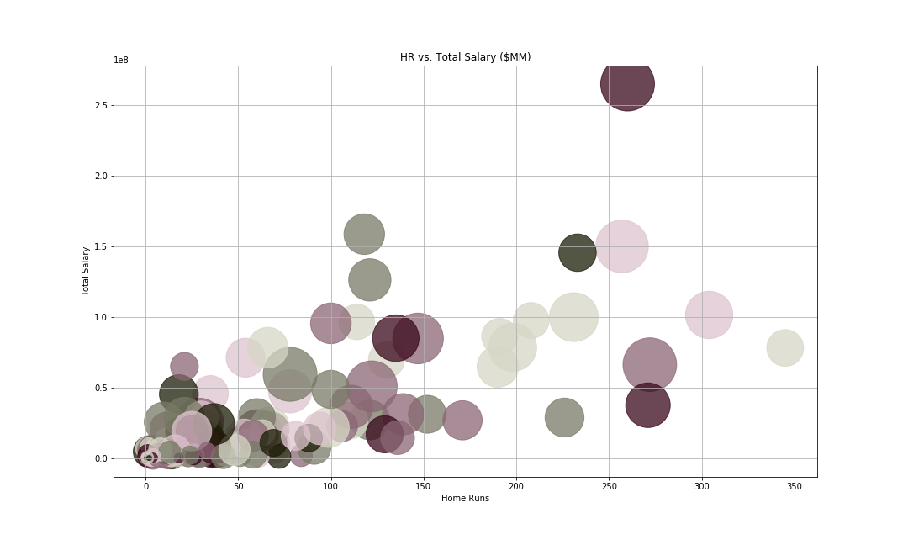
HR vs Total Salary

Slide 12
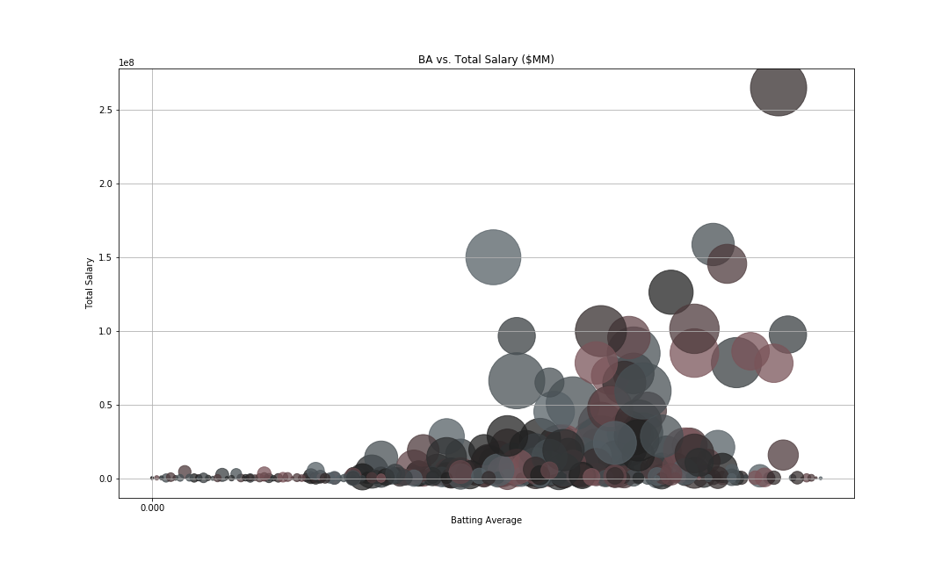
BA vs Total Salary

Slide 13
Salary vs Team’s Outcome
Evaluate if the costliest Home Runs per Shortstop influenced the team’s season.
-A team’s success is measure by outscoring the opponent in 162 games in a MLB season.
by Javier Lopez

Slide 14
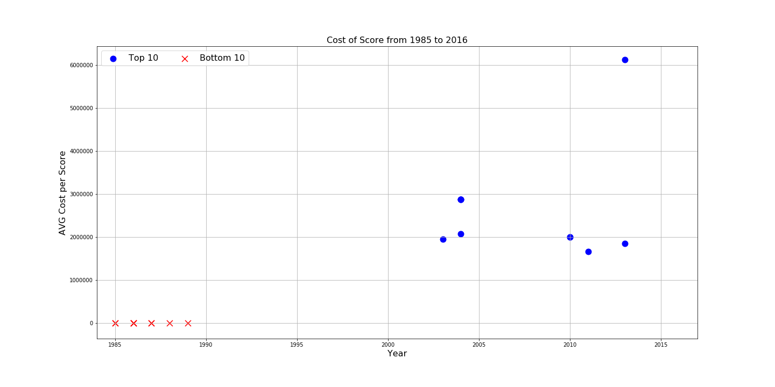

Slide 15
Cost of Score
Cost per score starts to mark in the millions in 2003.
Michael Young in 2013 has the highest cost per score for Los Angeles Dodgers.

Slide 16
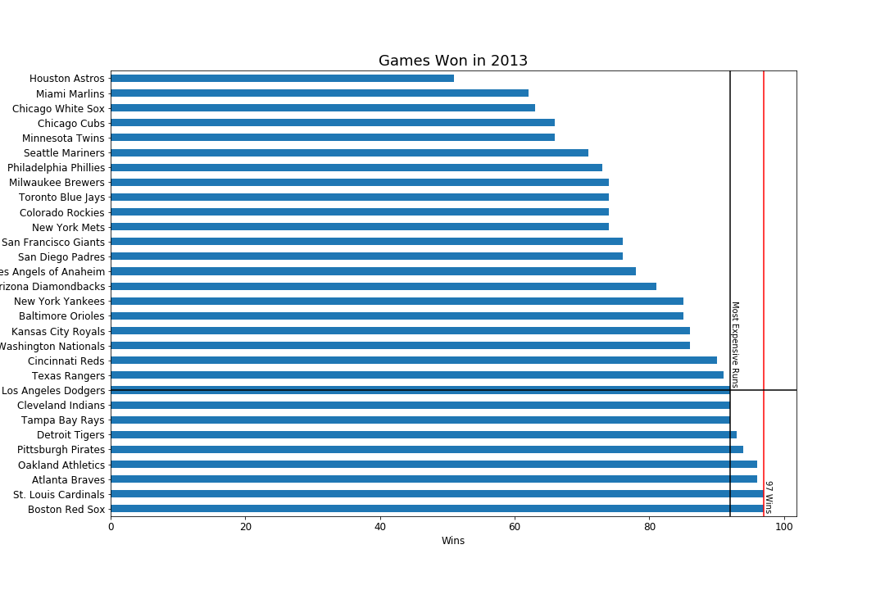

Slide 17
Following Up on 2013 Season
LA Dodger’s made it to the National Championship.
Boston and St. Louis played in the World Series.

Slide 18
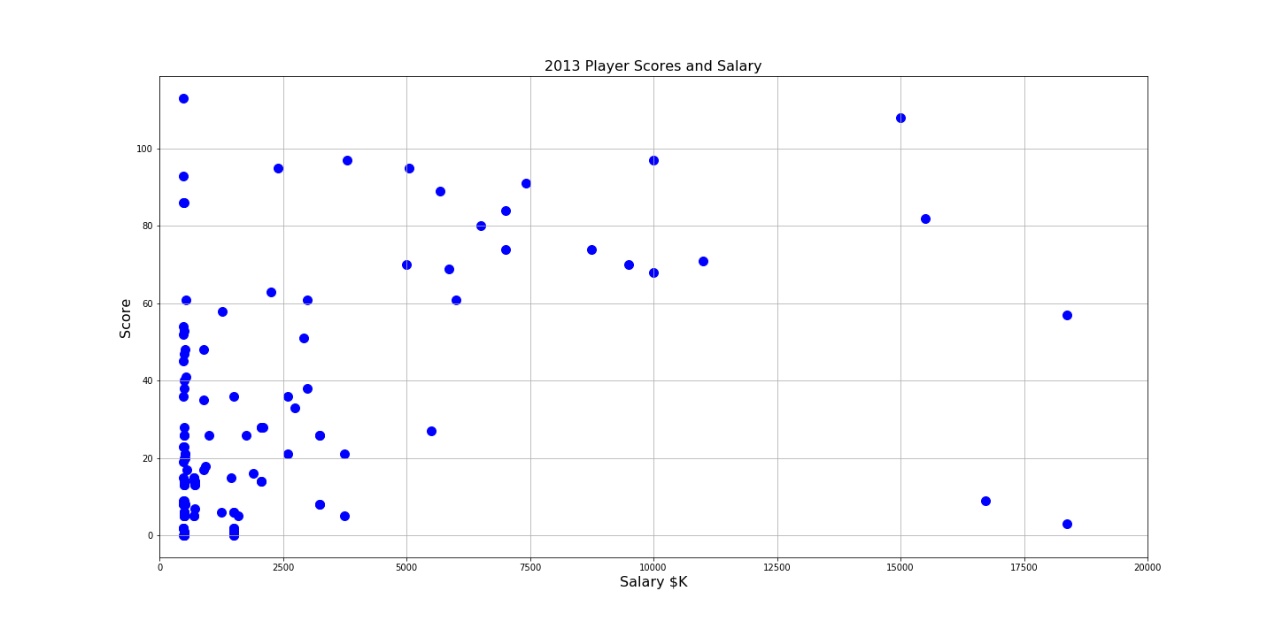
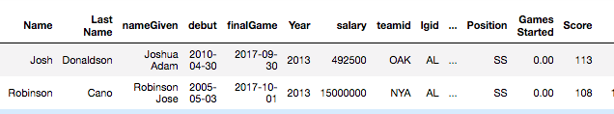

Slide 19
2013 Short Stop Players
In 2013 three groupings occur at low, mid and high salary.
Boston had the highest paid Short Stop players and won the World Series.

Slide 20
Salary Analysis
How has SS salary changed over time after adjusting for inflation?
by Bryan Fawcett

Slide 21
Salary Analysis
Grouped player salary data by year and calculated the mean.
Retrieved inflation data from the Bureau of Labor Statistics.
Adjusted mean player annual salaries by inflation rate.

Slide 22
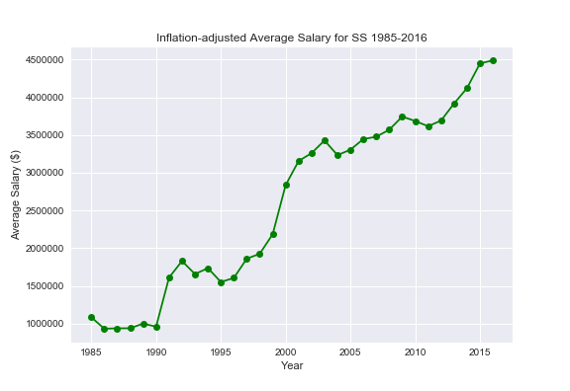
Salary Analysis
Notes:
Noted consolidation periods during decades with considerable stair-step rises at the transition of decades.

Slide 23
Salary Analysis
For perspective, compared percentage change in adjusted SS salary to percentage change in real median household income.
Possible that thriving economy lifted all income?
Retrieved real median household income data from FRED (St. Louis Fed).

Slide 24
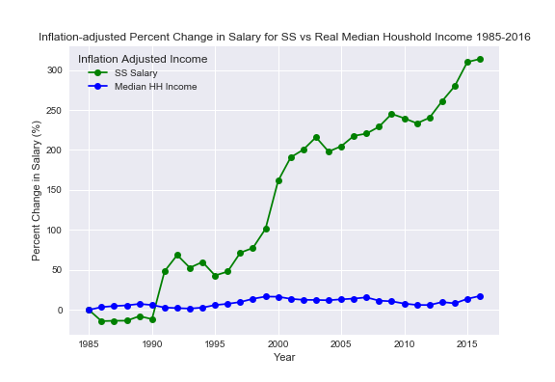
Salary Analysis
From 1985 to 2016, real median household income increased by ~17.5%.
Real SS salary increased by ~313.8%.

Slide 25
Salary Analysis
1985-1987: Baseball commissioner met with general managers advising them to hold down player salaries by any means necessary.
Final settlement of three collusion cases reached in 1990.
Strike in 1994 led to “Luxury Tax” rather than traditional salary cap. (1997-1999 and 2002 to present)
Further research on MLB salary caps.

Slide 26
Further Questions and Implications
What is the effect of contractual salary on a player’s performance throughout the life of the contract? Do players perform better in the year of their contract expiring, or just after having signed a new contract?
Are there particular divisions that seek to invest additional salary into a particular position based on the competition within the division? Any division’s that have a tendency to spend a lot at a certain position?
How does net profit from ticketing and merchandise effect a team’s willingness to marginally increase salary for a position, or team salary overall?
Is there a trend or peak of the ratio of SS (or any position) salary: rest of team salary?
Marginal increase in salary of what single position offers most gains of team wins?

Slide 27
Conclusion

